Slide 1
Crimson Clubs
Adam Gabriel, Max Livingston, Travis Redfield, Maclane May, Taylor Meads

Slide 2
Review
App/Website
Allows students to manage their clubs and teams
Can work for clubs/intramurals/informal groups

Slide 3
Definitions
Admin User – Club leaders, officers, faculty advisors, etc. who have more privileges for a specific club than others. Doubles as a standard user.
Standard User – A normal user with normal privileges.

Slide 4
Functional Requirements (Admin)
Add other people/Approve people
Create Events
Push Notifications
Remove People
Modify Description/Info/Tags
Add Stats (Low)

Slide 5
Functional Requirements (Normal)
Request to Join Club/Join Club
Search Clubs
Look at Personal Calendar
Leave Clubs
Look at info
Create Profile
View Event Stats/Leagues (Low)

Slide 6
Non-Functional Requirements
Login
Save to backend
Flexible UI for website and app
Profile Management (?)
Search Algorithm based on Profile/Tags (?)

Slide 7
Discussion of what is required/possible/low priority/future
I’m not totally sure if we need this slide or if it can be merged with the requirements slides or the System evolution slide.

Slide 8
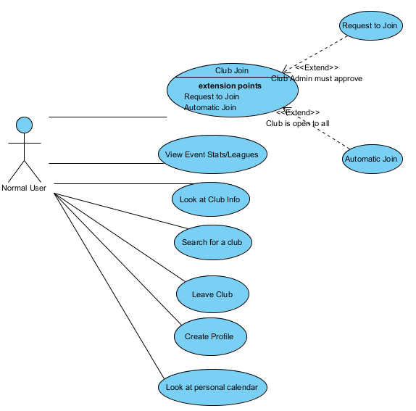
Normal User Use Case Diagram

Slide 9
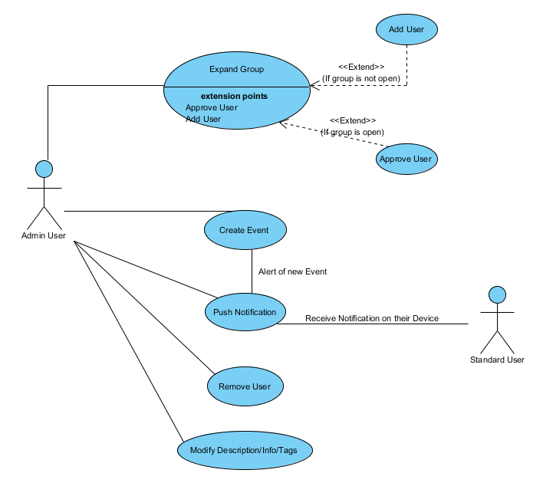
Admin User Use Case Diagram

Slide 10
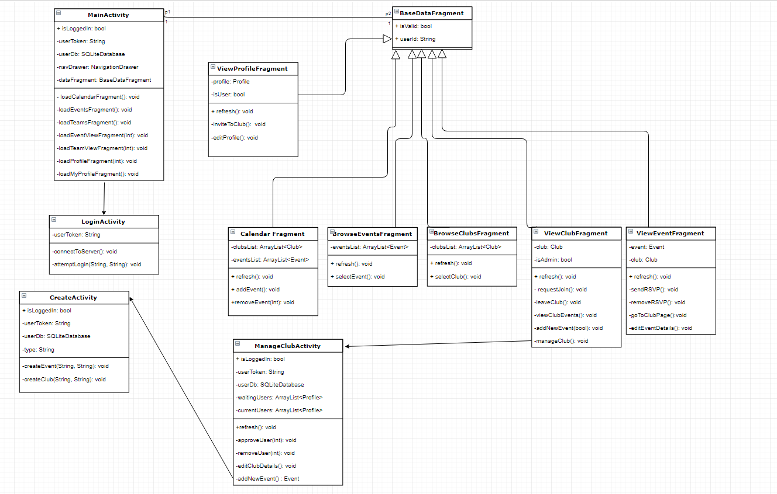
Class Diagram

Slide 11
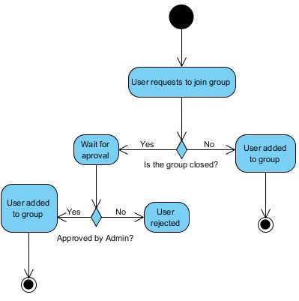
Add User

Slide 12
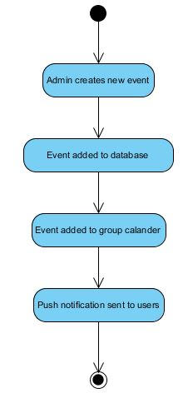
Create Event

Slide 13
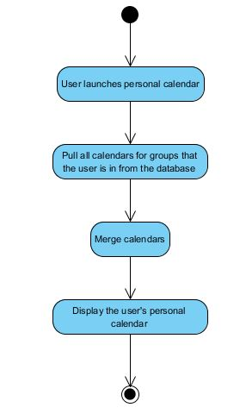
Display Personal Calendar

Slide 14
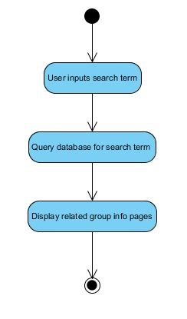
Search Clubs

Slide 15
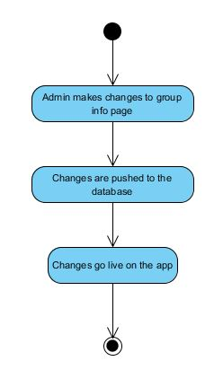
Update Club Info

Slide 16
Website
The frontend website will use AJAX calls instead of form submissions.
The backend will be C# .NET using MVC.
The database with be T-SQL.

Slide 17
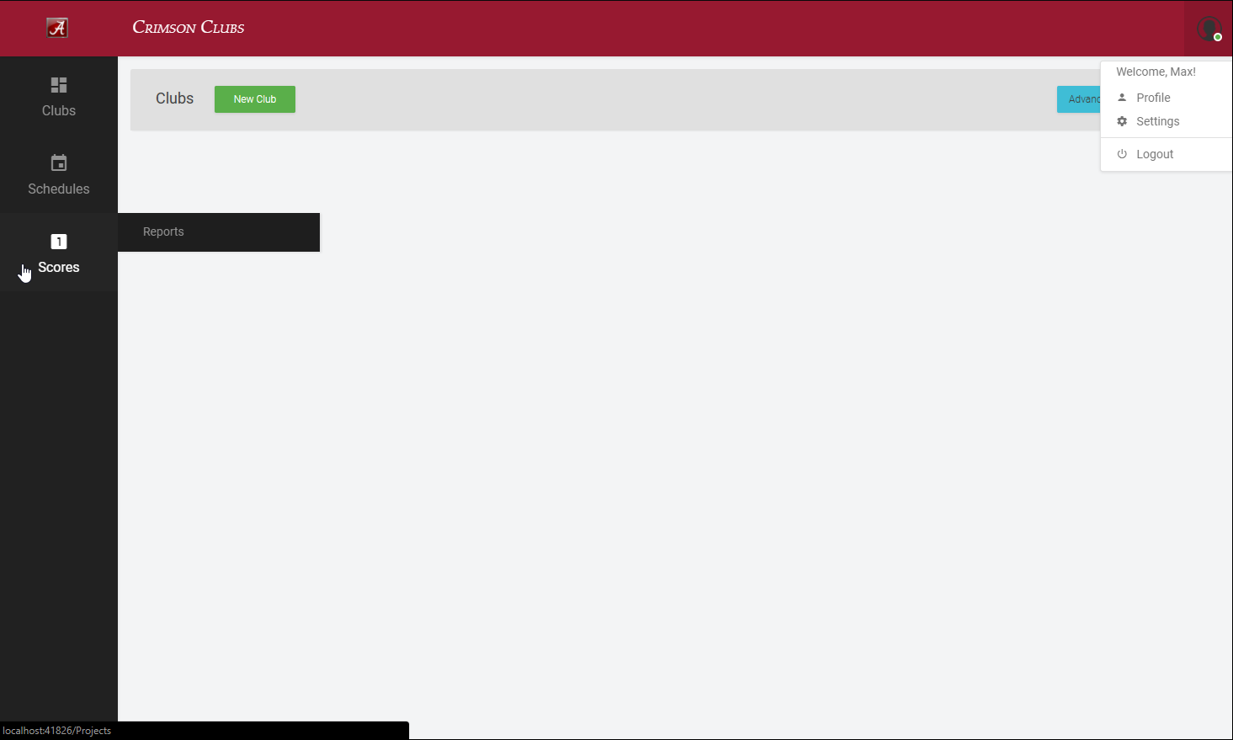

Slide 18
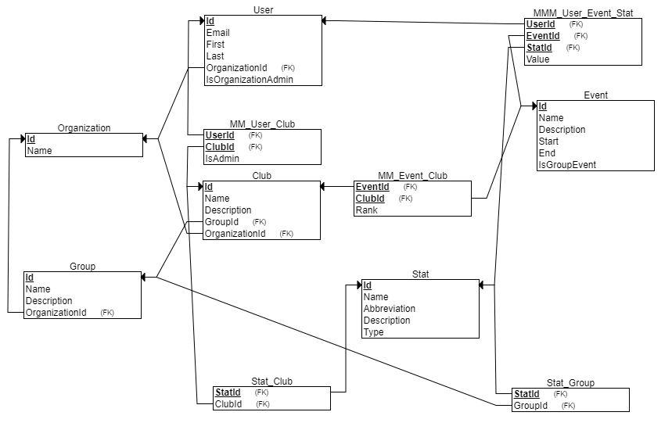

Slide 19
System Evolution
Intramural Referee tools
Club matching algorithm

Slide 20
Potential Risks
Security (login and personal information)

